Slide 1



LOW VOLTAGE BATTERY DATA FOR HIGH-SPEED TRAINS
Group 9
Donato D’Ambrosio M62002985
Antonio Fico M62002880
Ehsan Seyedabadi P55000046
Professor: Prof. Antonio Lepore
Course: Statistical Lab for Industrial Data Analysis

Slide 2

TABLE OF CONTENTS
INTRODUCTION TO HITACHI RAIL AND PROJECT GOALS
DATASET AND SYSTEM ANALYSIS
DATA MANIPULATION AND EXPLORATION
STATISTICAL QUALITY CONTROL
CONCLUSION AND FUTURE PERSPECTIVES

Slide 3
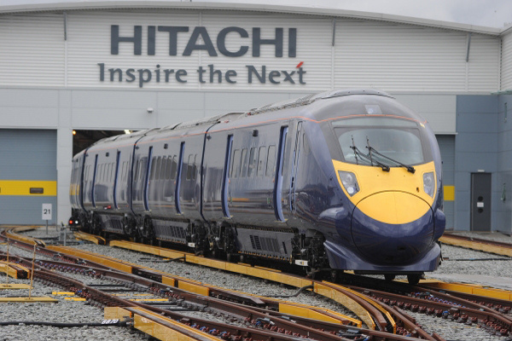
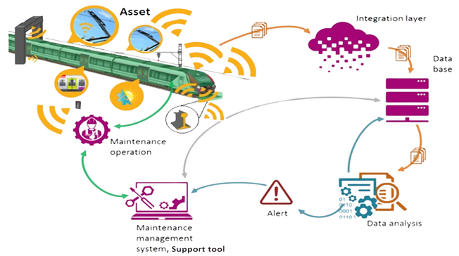
THE COMPANY
Founded in 1924, Hitachi Rail, a division of Hitachi Ltd., specializes in advanced railway systems manufacturing
The Hitachi Mission, set by founder Namihei Odaira, is to deliver superior, original technology and products for mobility projects around the world
Committed to driving the sustainable mobility transition and has a clear focus on partnering with customers to rethink mobility
Present in 140 countries with over 270,000 employees and global revenues of €54.55bn / ¥8,564 bn

Slide 4

OBJECTIVES
Use statistical methods to make predictions in order to identify faulty batteries
Identify critical trains in relation to battery behavior

Slide 5

THE DATASET
Data from FLEET_1 high-speed trains
Focus on Ni-Cd low-voltage batteries (4 Batteries per train in parallel connection)
Key Variables:
IBatt_Ci: Current intensity
VBatt_Ci: Battery voltage.
ID_Ph_Ci: Battery phase
ID_GR: Discharge-charge group
Timestamp: Sampling time
Vehicle: Identification code (16 trains).
GPS_LAT/LON: Vehicle position.
VEHICLE_SPEED: Speed in km/h.
Status_ID: Vehicle status

Slide 6
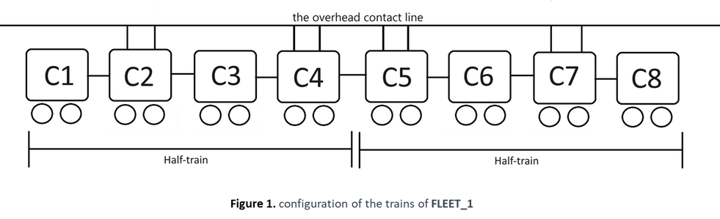
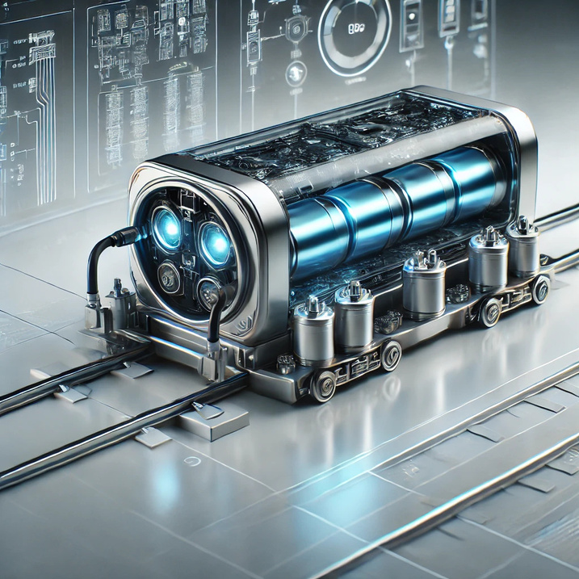
THE SYSTEM
System Overview:
Ni-Cd low-voltage batteries
4 batteries per train
Key Functions:
Start-up: Power peak
POC (Point of Change)
High Voltage faults
Maintenance:
Focus on Discharging Phase:
Disparities in discharging currents among the 4 batteries can identify faulty batteries.
Discharging voltage reflects the health of the low-voltage system.

Slide 7

DATA MANIPULATION
Data Filtering
Power Calculation
Discharge Phase Identification
Timestamp Conversion
Visualization

Slide 8
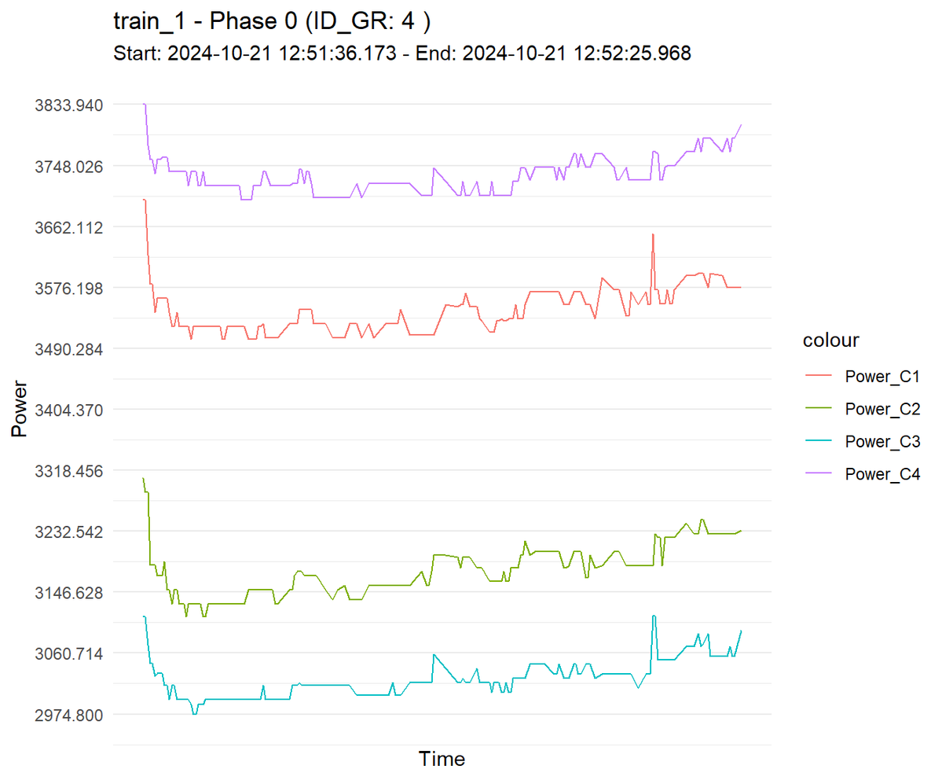
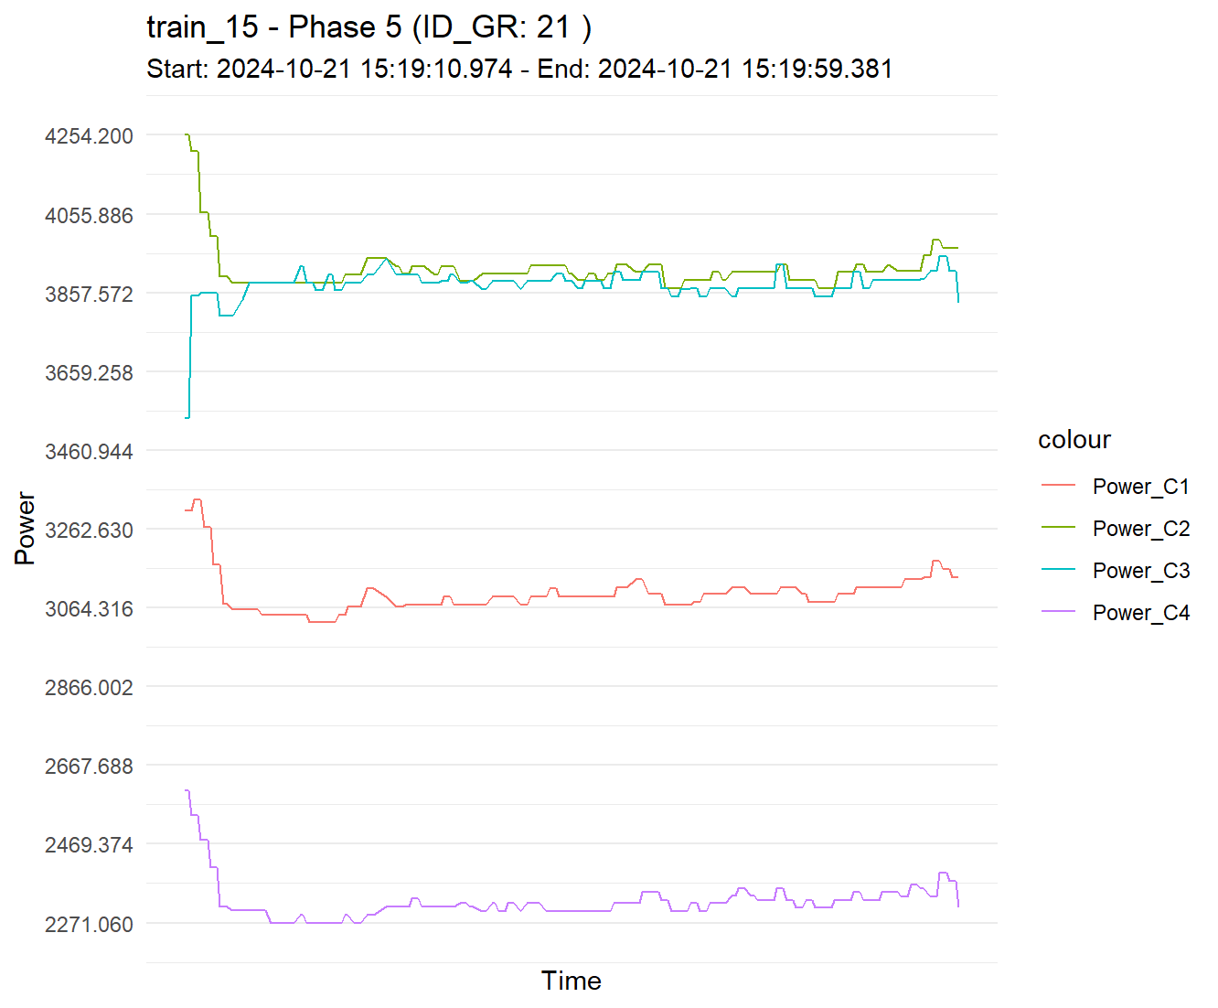
DATA EXPLORATION

Slide 9
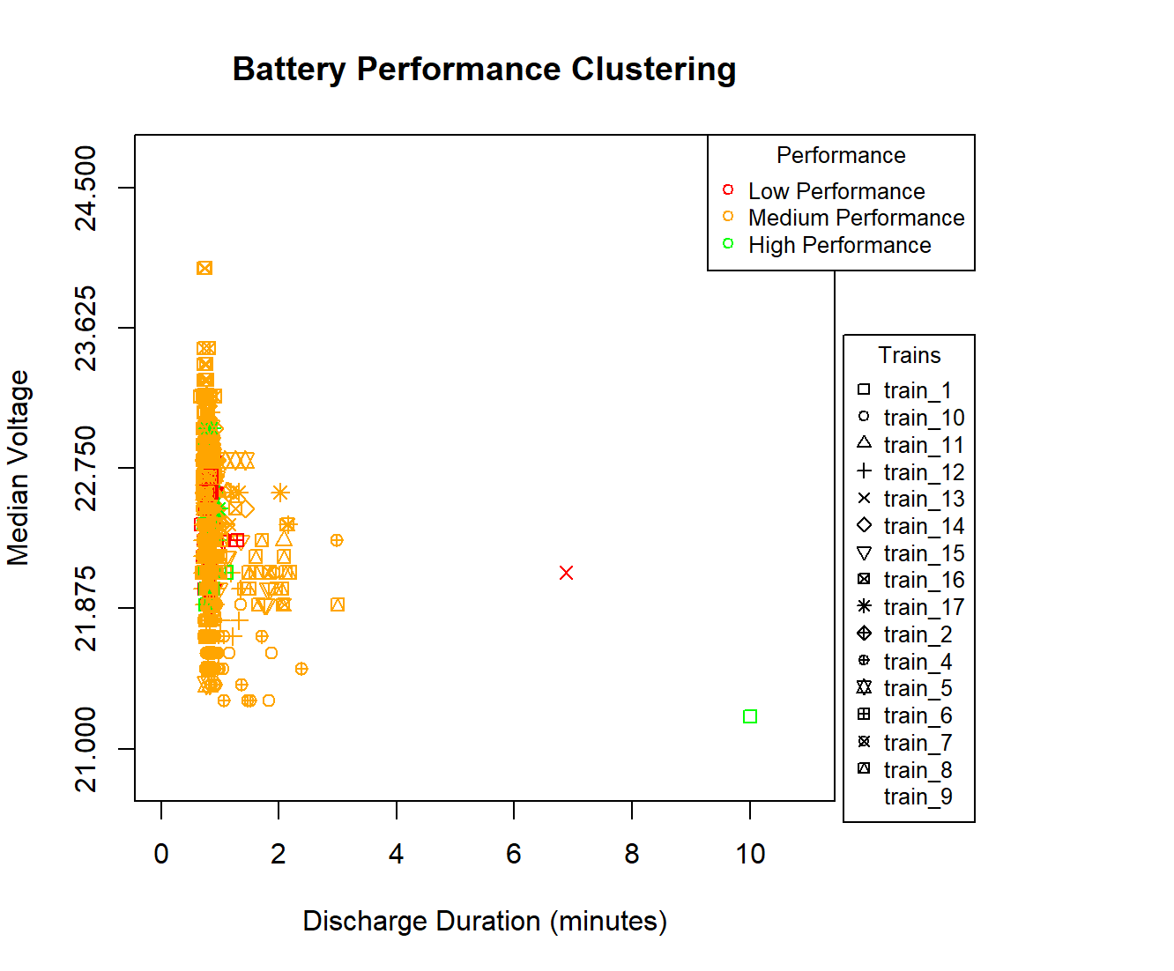
DATA EXPLORATION
Clustering: K-means with 3 centers
Features: Median voltage & discharge duration
Our Classification:
Low performance: High Voltage & short discharge duration
Medium performance: Neither lower nor higher
High performance: Low voltage & long discharge duration
Visualization: Different markers for each train

Slide 10
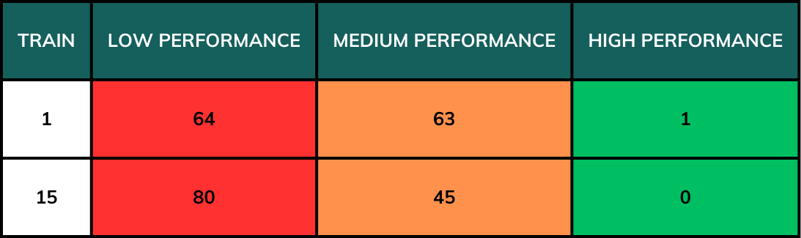
DATA EXPLORATION

Slide 11
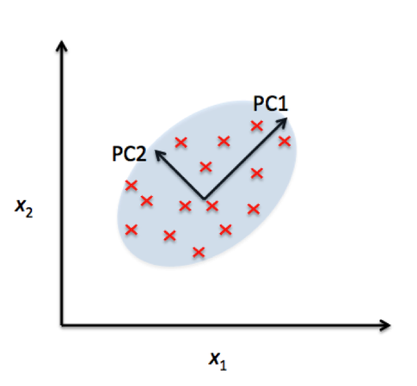
DATA EXPLORATION
Principal Component Analysis (PCA)
K-Means Clustering
Goal:
Importance of identifying different discharge behaviors using PCA & clustering.
Apply PCA to extract key features and K-means clustering for grouping similar behaviors
To analyze battery discharge patterns and classify them into different groups based on their characteristics.
PCA is used to:
Reduce dimensionality while preserving variance.
Find patterns in high-dimensional data.
PCA transforms the dataset with correlated variables into new uncorrelated features (Principal Components).

Slide 12
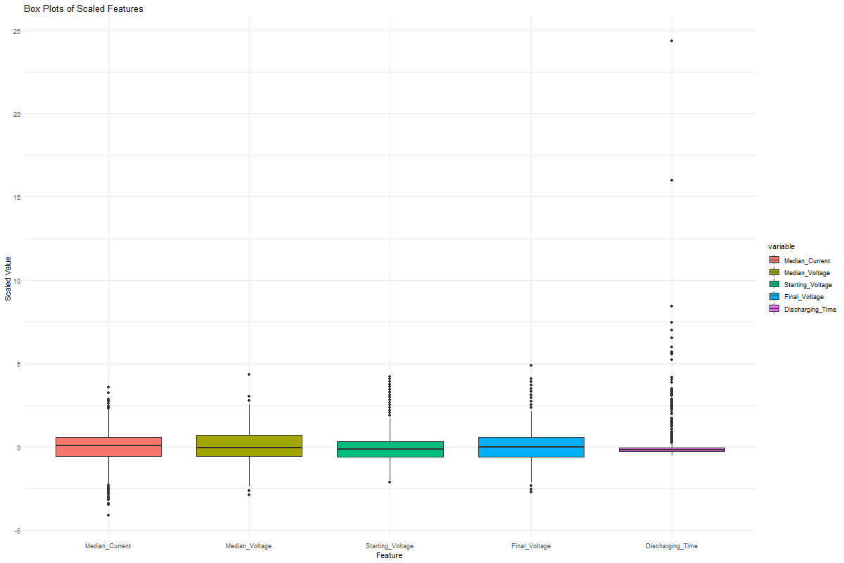
DATA EXPLORATION
Box Plots
The dataset contains battery discharge information for multiple trains.
Features included:
Median Current
Median Voltage
Starting Voltage
Final Voltage
Discharging Time
Preprocessing steps:
Selected only discharging phases ("S").
Standardized the data to ensure fair comparisons.

Slide 13
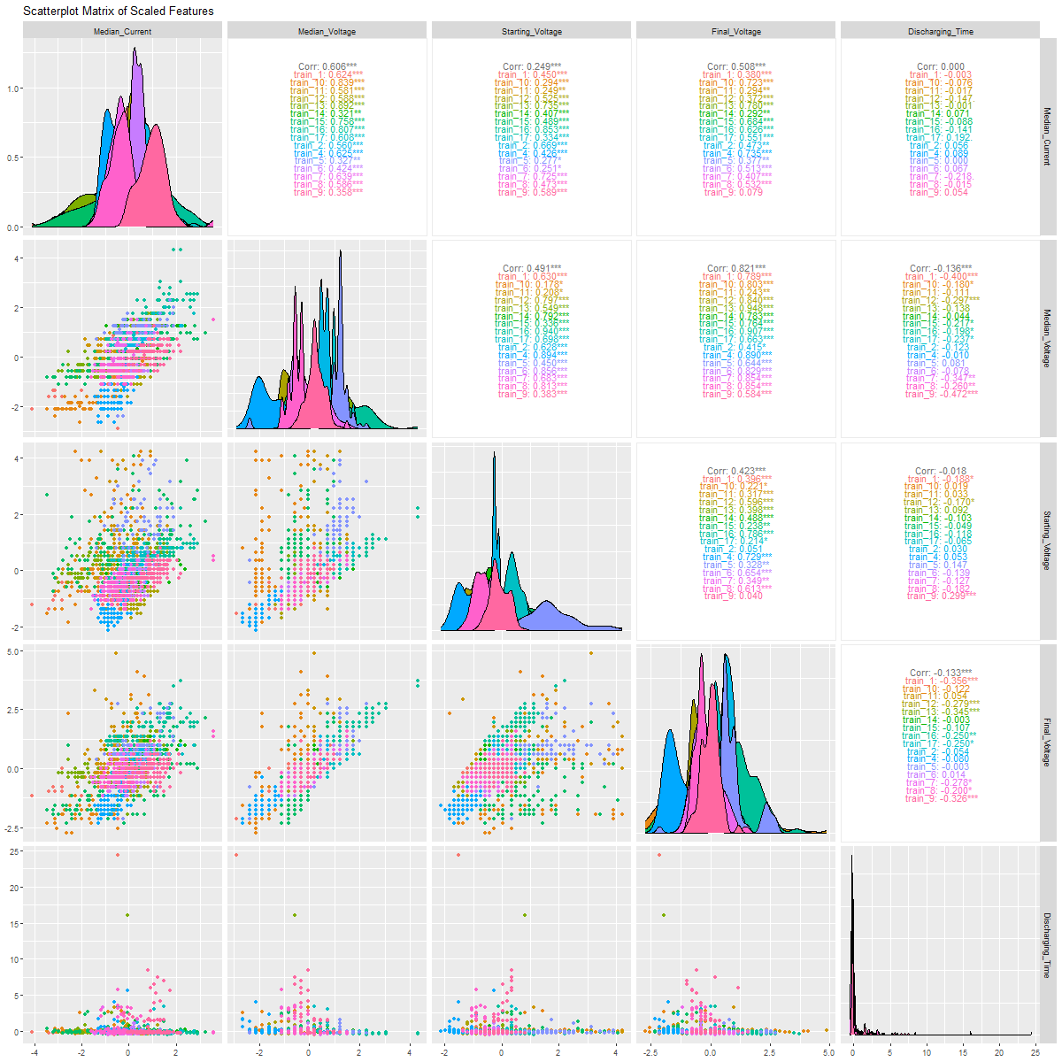
DATA EXPLORATION
Scatter plot Matrix of scaled features

Slide 14
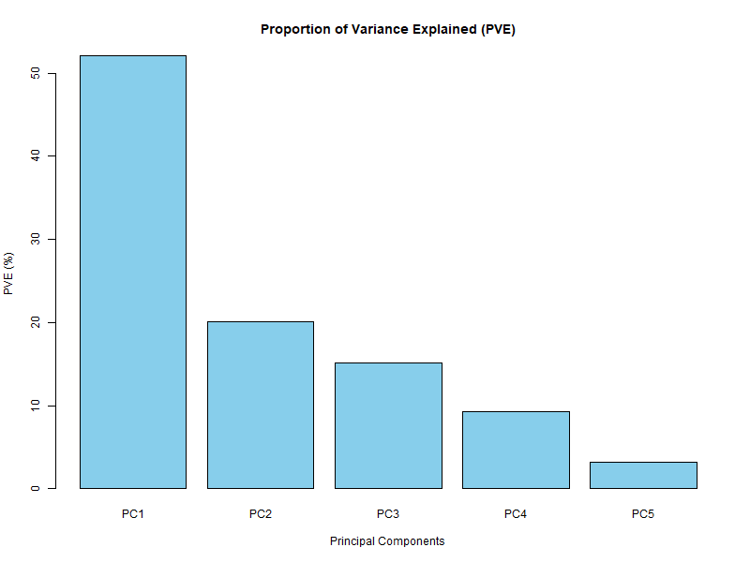
DATA EXPLORATION
Results of PCA
PVE (Proportion of Variance Explained) Plot:
PC1 explains ~50% of variance.
PC2 explains ~20% of variance.
PC1 & PC2 together explain ~70% of the dataset variation.

Slide 15
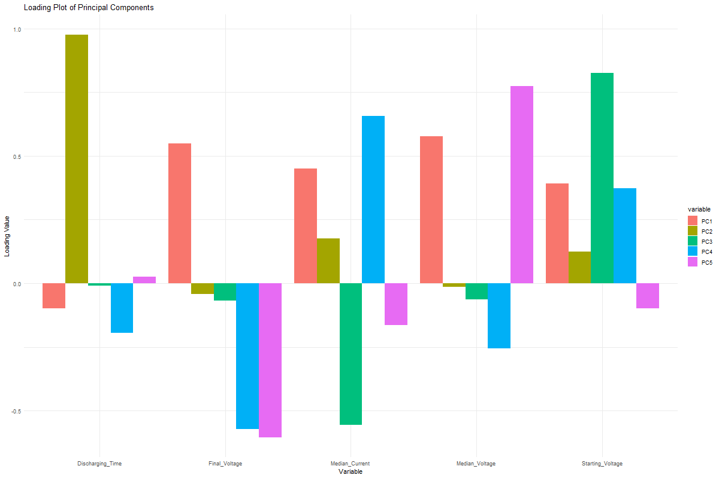
DATA EXPLORATION
PCA Interpretation
(Loading plot)
Loading Plot:
PC1 is mostly influenced by Discharging Time & Final Voltage.
PC2 is influenced by Median Current & Starting Voltage.

Slide 16
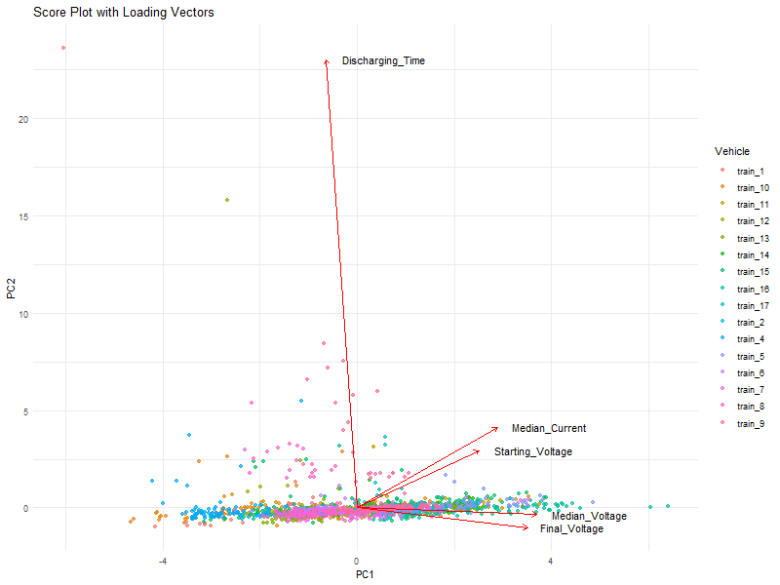
DATA EXPLORATION
PCA Interpretation
(Score Plot)
Score Plot with Loading Vectors:
Shows how observations (batteries) are distributed in the new PCA space.
Loading vectors indicate which variables contribute most to PC1 and PC2.

Slide 17
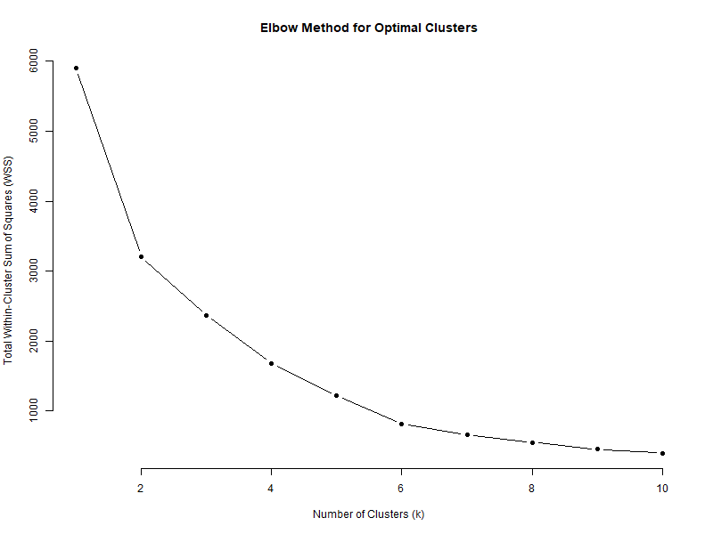
DATA EXPLORATION
K-Means Clustering on PCs
Clustering is applied to principal components to find groups of similar battery behaviors.
K-means clustering groups observations into K clusters based on their similarity.
Elbow Method is used to determine the optimal number of clusters (k).

Slide 18
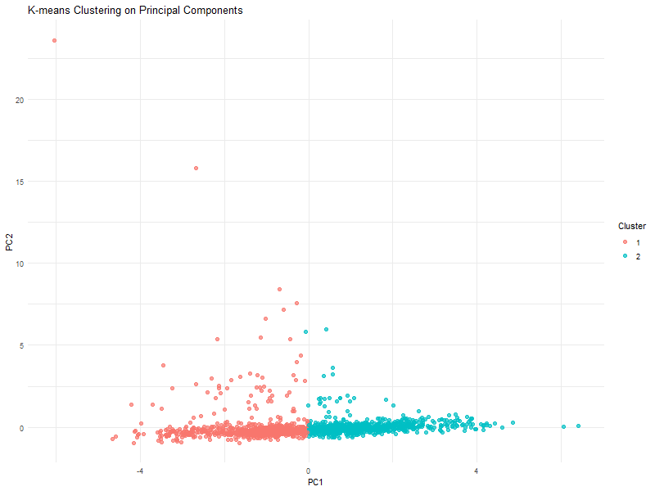
DATA EXPLORATION
K-Means Clustering Results
& Interpretations of Clusters
K=2 was chosen as the optimal number of clusters.
The clusters are visualized in the space of PC1 vs. PC2.
Each cluster represents a different type of battery discharge behavior:
Cluster 1 (Blue):
High discharge intensity, short discharge duration.
Batteries under heavy load, possibly in start-up phases.
Cluster 2 (Red):
Low discharge intensity and medium discharge duration.
Represents normal operational behavior.

Slide 19

STATISTICAL PROCESS CONTROL
Process Monitoring
Control Charts
Defects & Nonconformities
Sampling Techniques

Slide 20
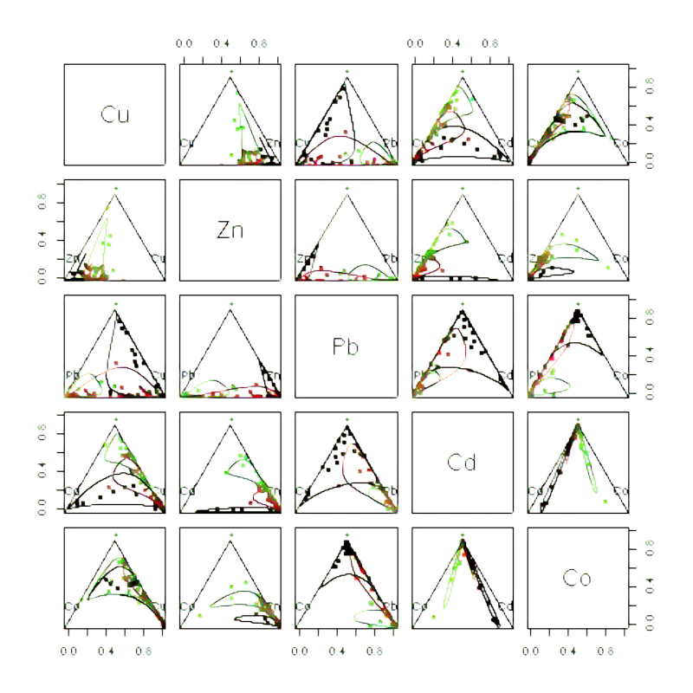
MULTIVARIATE SPC:
T² CoDa CONTROL CHARTS
Creation of a dataset with the median powers of the train 1 for every discharge phase;
Dataset split in PHASE I(80%) and PHASE II(20%);
Compositional Data Transformation to make a multivariate process control;
Application of control charts on train 1;
Evaluation of the model on train 15;
Example of Compositional Data

Slide 21
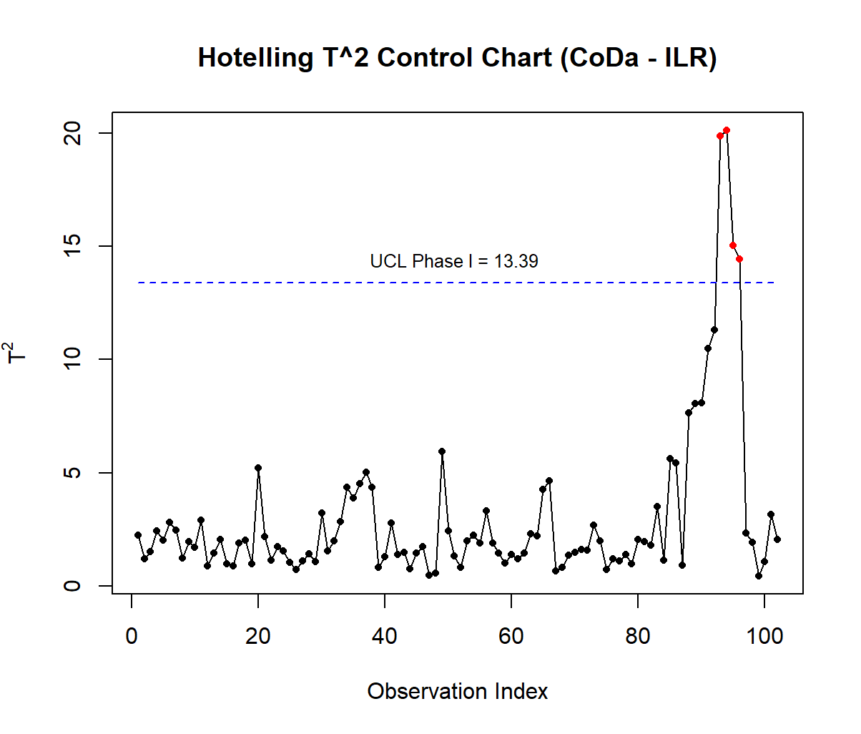
T² CoDa CONTROL CHARTS
PHASE I:
Data processing: taking the median power of the batteries of train_1 for every discharge phase;
Compositional Data Transformation with «acomp» and «ilr» functions of R;
Calculation of sample mean and covariance matrix;
Computation of T² for every observation;
Definition of Upper Control Limits;
Identification of anomalous values;
Elimination of anomalous values;
Re-evaluation of the Control Charts

Slide 22
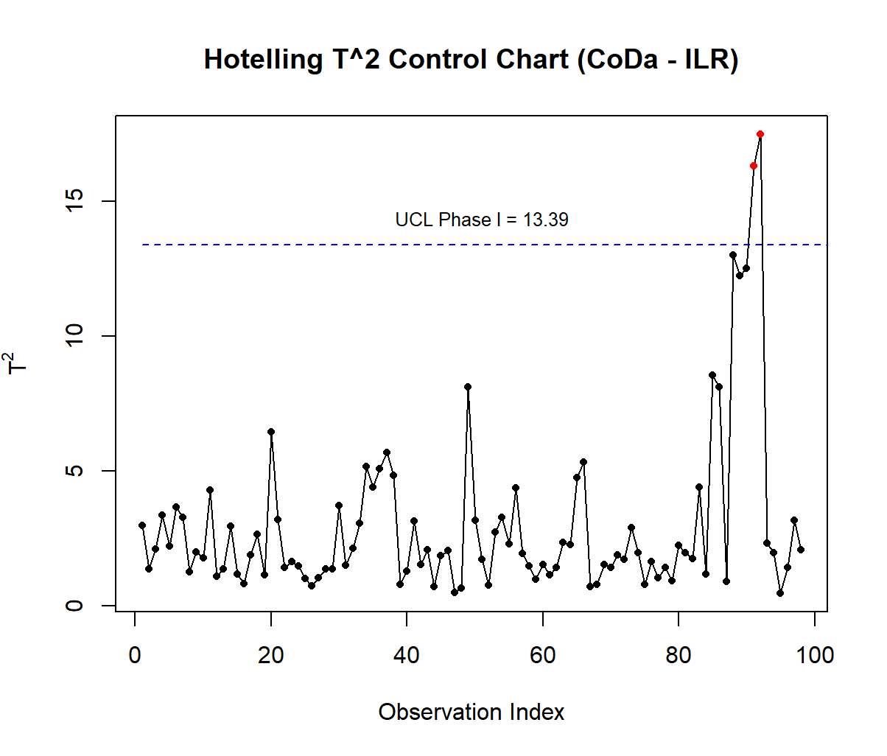
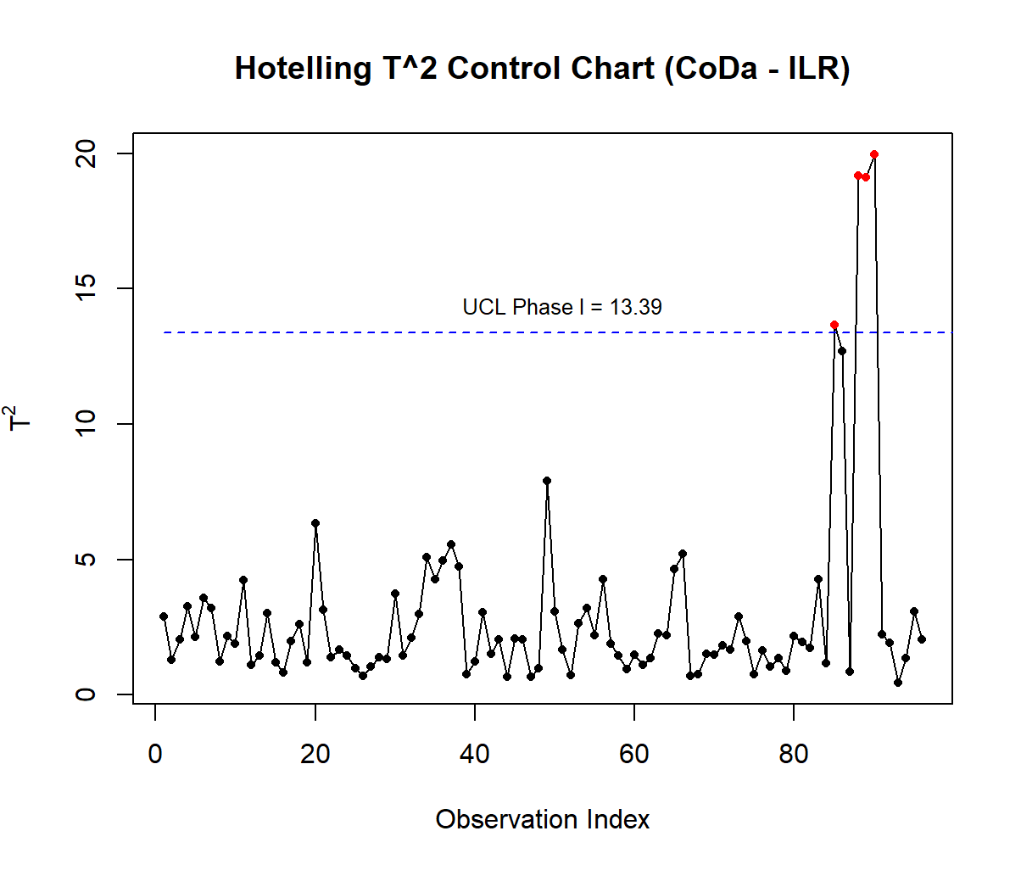
T² CoDa CONTROL CHARTS

Slide 23
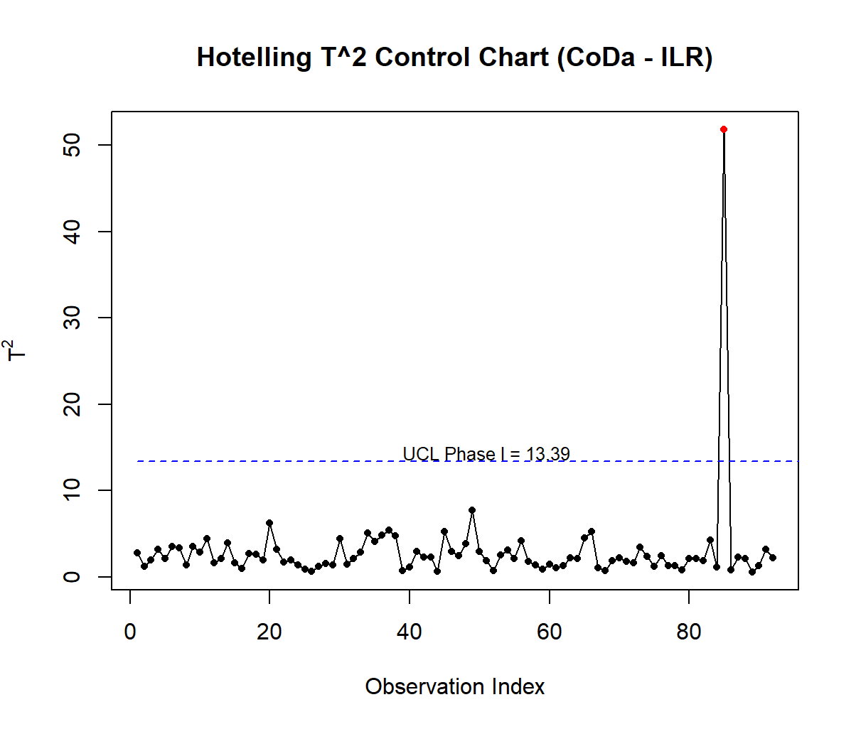
T² CoDa CONTROL CHARTS

Slide 24
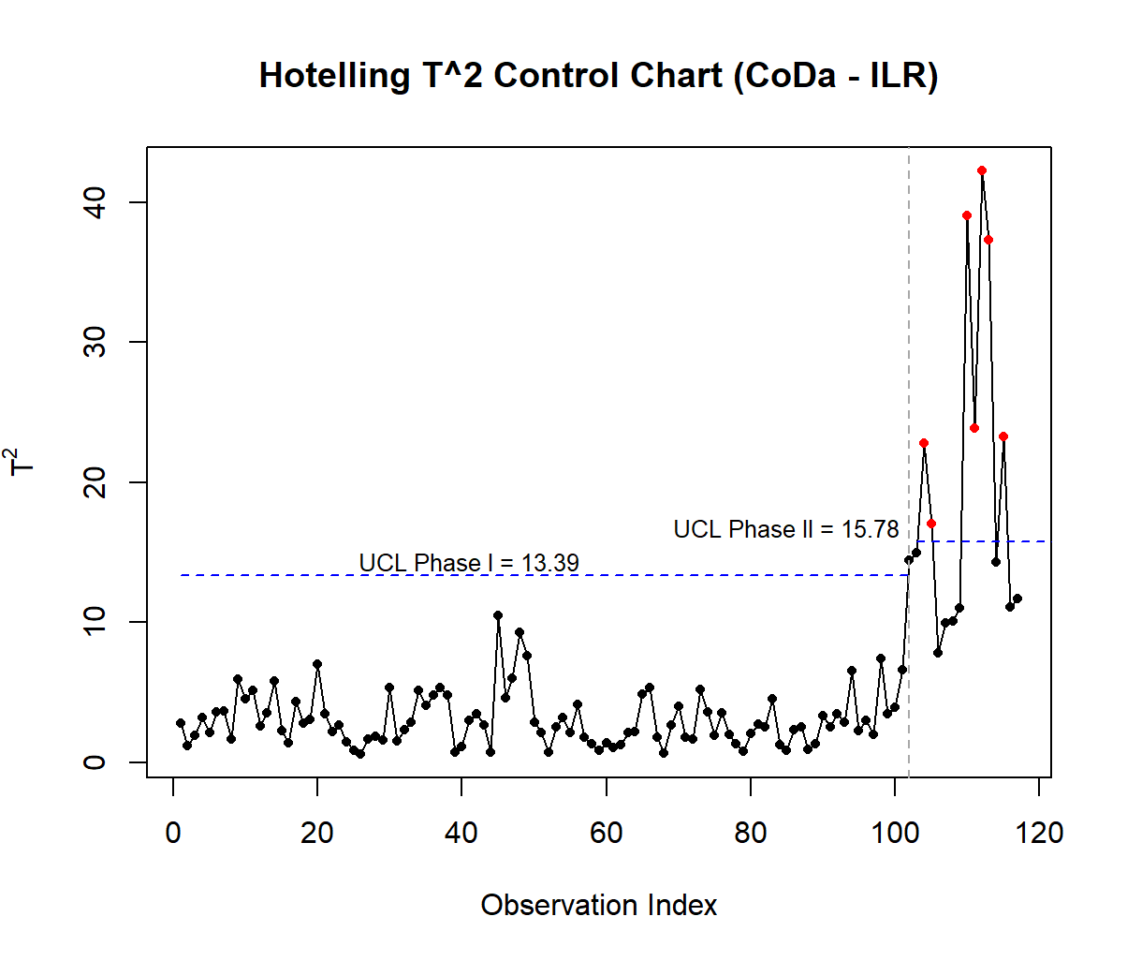
T² CoDa CONTROL CHARTS
PHASE II:
Calculation of T² values;
Evaluation of UCL
Monitoring the process

Slide 25
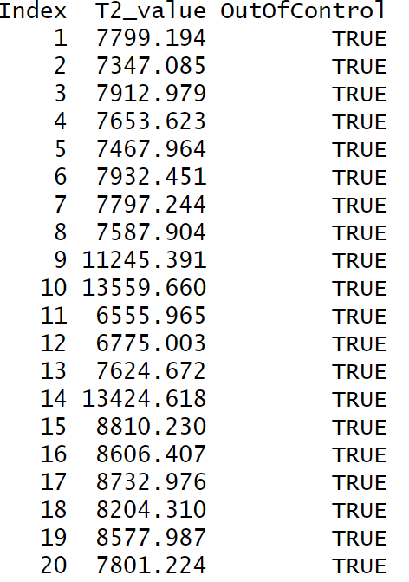
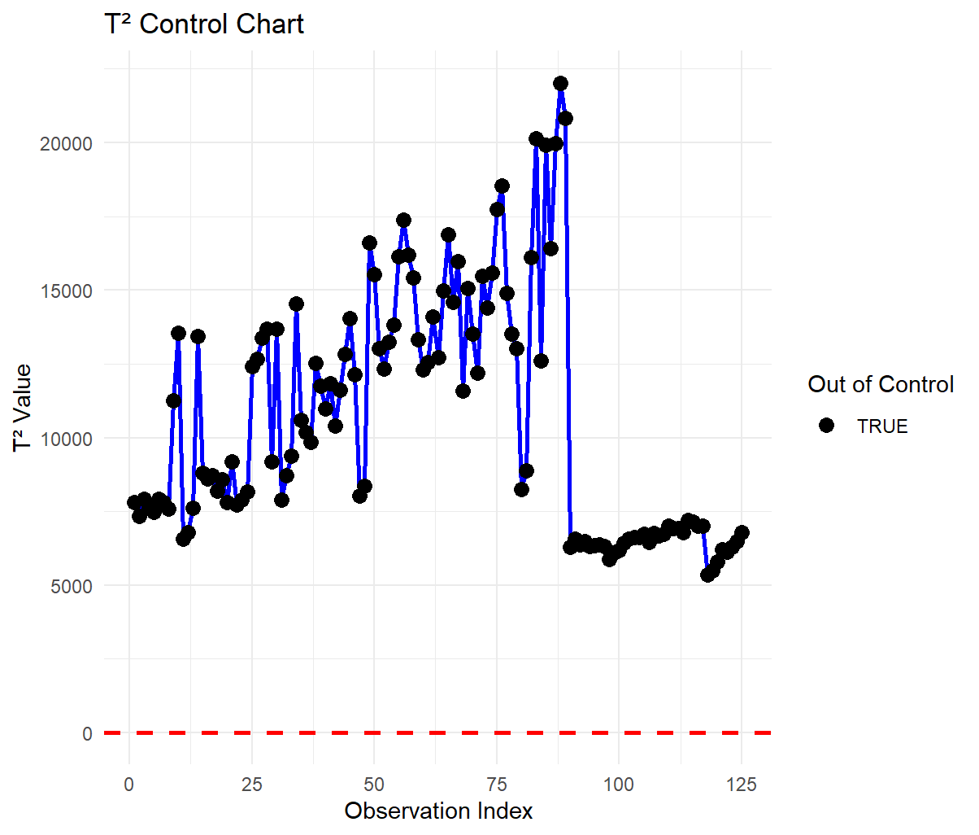
T² CoDa CONTROL CHARTS
VALIDATION OF THE MODEL WITH TRAIN 15

Slide 26
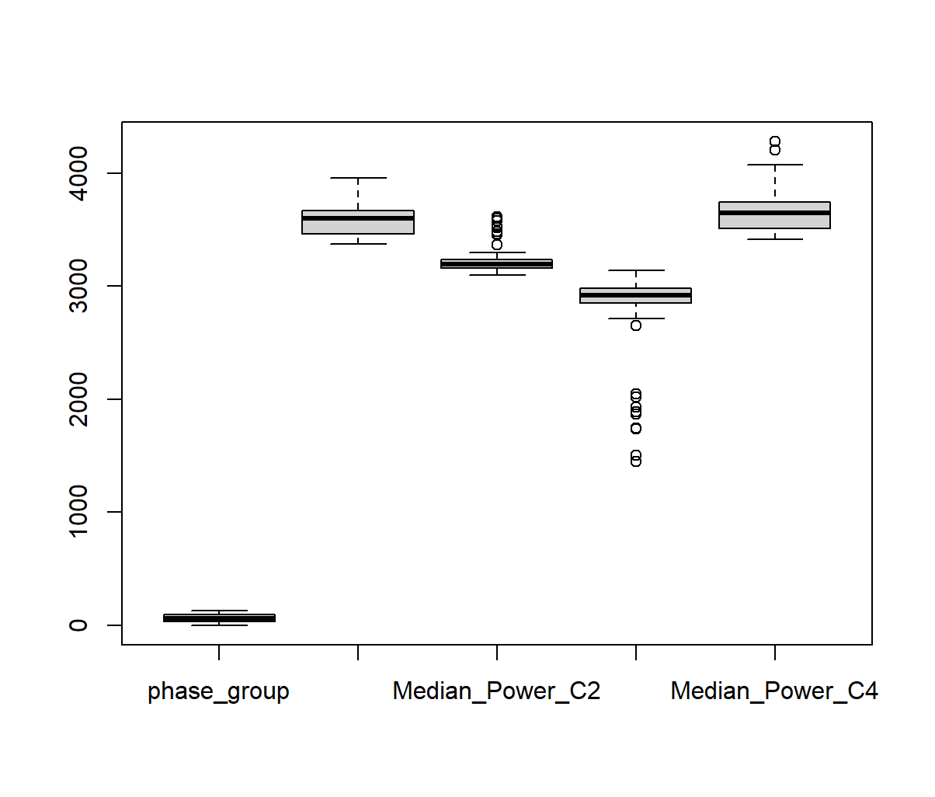
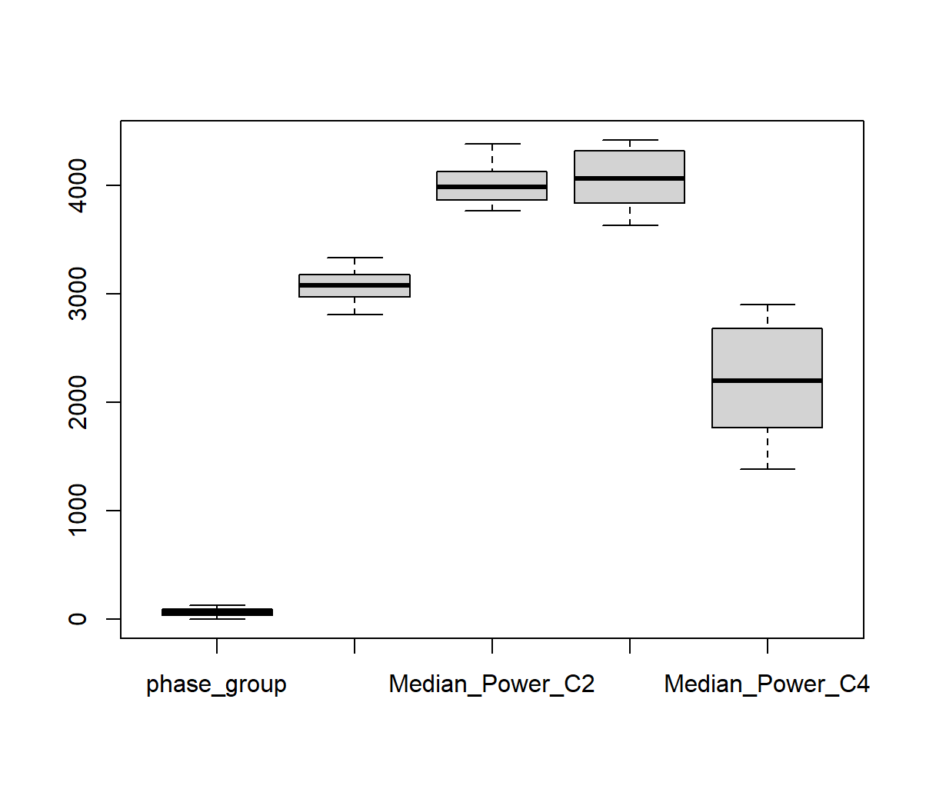
TRAIN 1 vs TRAIN 15
BOXPLOTS OF MEDIAN POWERS
Boxplot for median powers of train 1
Boxplot for median powers of train 15

Slide 27
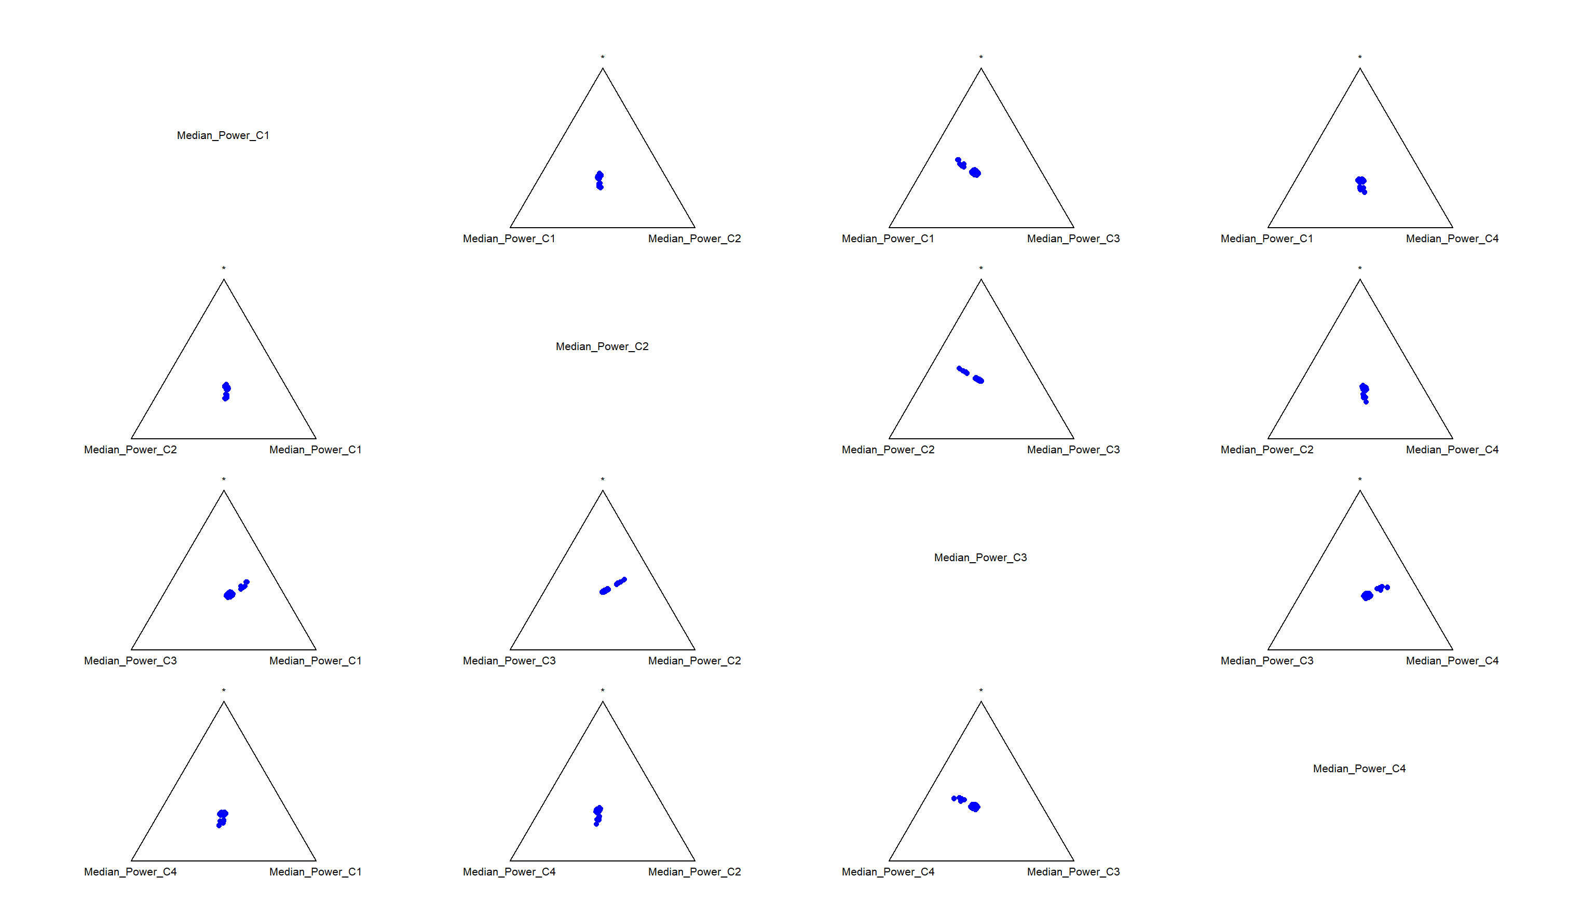
TRAIN 1 vs TRAIN 15
Ternary diagram for train 1

Slide 28
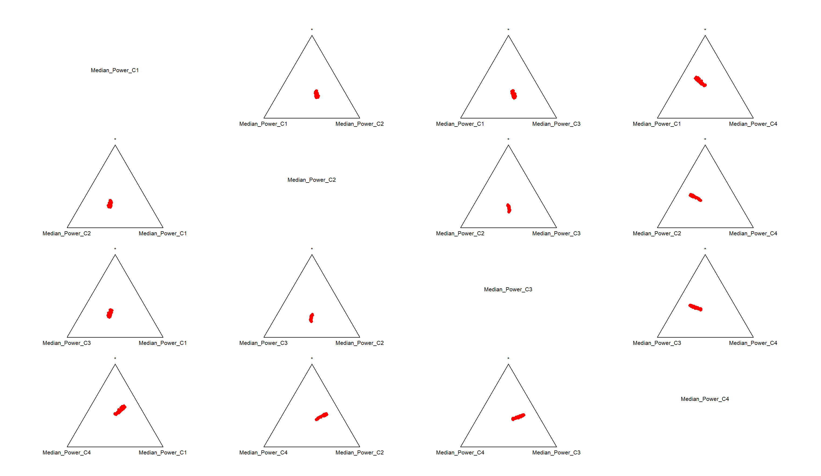
TRAIN 1 vs TRAIN 15
Ternary diagram for train 15

Slide 29
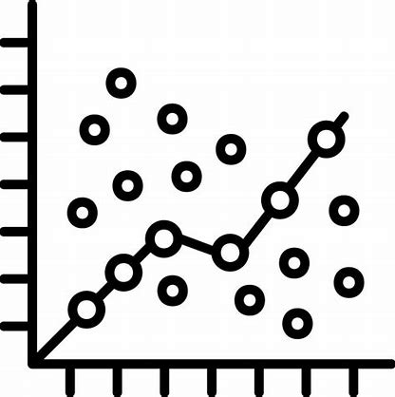

FUTURE PERSPECTIVES
Improve the T² CoDa framework to be scalable and generalizable across different trains
Ensure the model is resilient to variations in battery characteristics, operational conditions, and environmental factors
Combine the T² CoDa approach with machine learning models to predict battery degradation patterns.

Slide 30
THANK YOU FOR YOUR ATTENTION

